Slide 1


PRESENTED BY : ZUBAIR MAQBOOL
ENROLL : 4663
B.E : 7th
SECTION : B

Slide 2
CONTENTS
INTRODUCTION
COMPONENTS OF PASSIVE SOLAR BUILDINGS
DESIGN PRINCIPLES OF PASSIVE SOLAR BUILDINGS
METHODS OF DESIGN
CONCLUSION

Slide 3
INTRODUCTION
Solar building refers to use of sun light to heat and cool the living space of the building
TYPES OF SOLAR BUILDING
Active solar building
These buildings use mechanical devices such as pumps and fans to move the heat.
Photo voltaic panels are used to collect solar energy
Passive solar building
No mechanical devices are used in this building
It takes advantage of local breezes and landscape features
Simple system is used to collect and store sun energy

Slide 4
COMPONENTS OF PASSIVE SOLAR BUILDINGS
COLLECTION
it includes windows and skylights
its purpose is to allow sunlight into building to heat the space and storage mass
STORAGE
It stores collected solar heat
In most cases heat is collected in daytime & used at night
Storage subsystem includes parts of floor & interior walls of building
DISTRIBUTION
This system is accomplished by arranging the functional spaces of building
Distribution of heat takes place by combination of radiation and convection
4. CONTROL
A balance between size ;shape and location of sub system is achieved to ensure better performance of buildings.

Slide 5
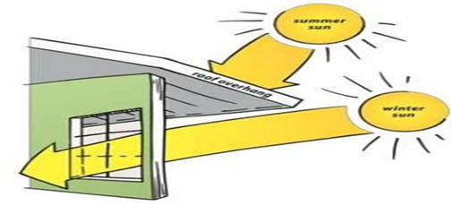
DESIGN PRINCIPLES OF PASSIVE SOLAR BUILDING
1.ORIENTATION
These buildings must be faced towards south direction
Longer side is oriented along east-west direction
No evergreen trees along face
2 OVERHANGS AND SHADING
These are used to let sunlight fall on glass during winter and to keep it off the glass in summer

Slide 6
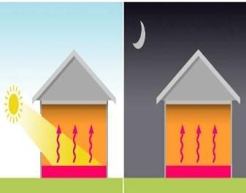
3.THERMAL MASS
It is a solid or liquid material that will absorb and store heat until it is needed

Slide 7
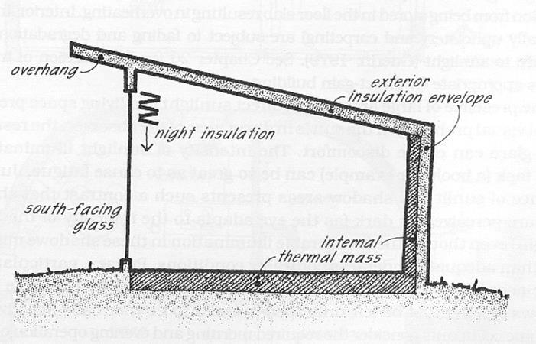
METHODS OF DESIGN
DIRECT GAIN METHOD
Actual living space acts as collector, absorber and distribution system
In this method 60 to 75% of solar energy striking the windows is utilized

Slide 8
RULES OF DIRECT GAIN METHOD
Thickness of thermal mass should be less than 6 inches
Thermal mass should not be covered with wall to wall carpeting
Use medium colour for masonry floor and light colour for walls
For every sq. feet of glass use 150 pounds of masonry
There should be no cavities in concrete block used as thermal mass
Surface area of thermal mass exposed to sunlight should be 9 times the area of glass

Slide 9
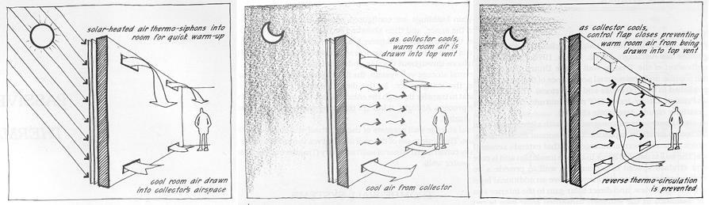
INDIRECT GAIN SYSTEM
Thermal mass is kept between glass and living space
This method will utilize 30 to 45% of sun energy striking the glass

Slide 10
Rules of indirect gain system
Exterior of thermal mass should be dark
Take a minimum space of 4 inches between glass and mass
Thermal mass should be 10-14 inches for bricks and 12-18 inches for concrete

Slide 11
Conclusion
Passive solar buildings are the part of green buildings by these buildings we are able to use solar energy and non renewable sources can be saved to large extent
It also reduces the cost of electric billing

Slide 12
Thank you

